Slide 1

Function Development
An Introduction to Programming in Python
Notes:
Let's learn more about Defining Functions.

Slide 2
Example
print((32 - 32) * (5/9))
print((50 - 32) * (5/9))
print((27 - 32) * (5/9))
Fahrenheit to Celsius conversion formula
Notes:
The code below converts a temperature from Fahrenheit to Celsius.
This code has some issues, however.
First, the calculation is called multiple times in the code, which makes it much more likely for a mistake to occur when typing it.
Second, if a mistake does occur, it will be harder to track down in the offending lines.
Third, anyone not familiar with the formula might wonder what this code is doing.
A function will help us with all of these problems.

Slide 3
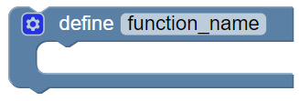
1) Start the Definition
def function_name():
pass
Notes:
We begin with the skeleton of a function.
In BlockPy, the Function block generates this function, ready for editing.

Slide 4
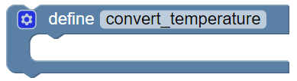
2) Name the function
def convert_temperature():
pass
Notes:
If you cannot name a function, then you probably don't know what it should do.
We know that this function will convert a temperature, so let's call it convert_temperature.
This name is short and has a verb.
Notice how I used underscores to represent spaces, because function names follow the same rule that variables do.

Slide 5

3) Find Commonalities
print((32 - 32) * (5/9))
print((50 - 32) * (5/9))
print((27 - 32) * (5/9))
Notes:
You need to identify what is the same and what is different about each call.
Extract out the code that is the same.
Here, we've extracted out the calculation.
We could have extracted out the print too, but remember that printing and returning are different.
Usually, functions don't need to print anything.

Slide 6
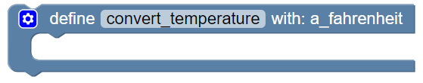
4) Parameterize
def convert_temperature(a_fahrenheit):
pass
Notes:
Notice the blank in the code we extracted.
Since the value we converted was different each time, we need to parameterize it by giving those concrete values a more general name.
In this case, each time it was a temperature in Fahrenheit, so we'll call this "a_fahrenheit".
We put this new parameter in the function's header and then use it in the body.

Slide 7
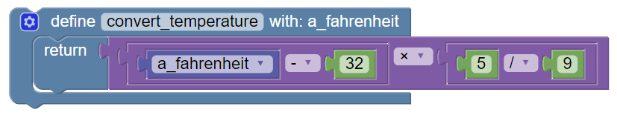
5) Return
def convert_temperature(a_fahrenheit):
return (a_fahrenheit - 32) * (5 / 9)
Notes:
The code we've created is meant to go inside the body of the function, but we have nothing to connect it to yet.
Recall that this function should return the temperature in celsius.
Therefore, we need a return block.
This gives us the open connection we need to incorporate the formula we extracted earlier.

Slide 8
6) Call
def convert_temperature(a_fahrenheit):
return (a_fahrenheit - 32) * (5 / 9)
print(convert_temperature(32))
print(convert_temperature(50))
print(convert_temperature(27))
Notes:
Finally, we can now call our function in the code.
Notice how we connect the original values as arguments for our function call.

Slide 9
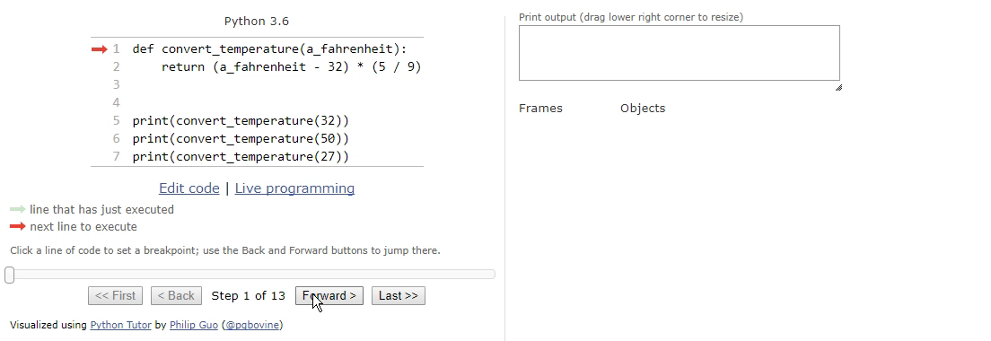
Watch the Execution
Notes:
So what actually happens when you call a function?
Let's see it in action.
Notice how the execution jumps BACKWARD when we call a function, and then returns later.
(You can view this yourself: https://goo.gl/TXXaBT)

Slide 10
Other Approach
def double(a_number):
return a_number * 2
print(double(32))
Notes:
Here, we turned existing code into a function definition and then called the function.
Another common approach is to do the opposite: write the function call, and then use that to write the function definition.
Use whichever order is more comfortable for you when solving each problem.

Slide 11
Functional Decomposition
Going to the store
Get to car
Drive car to store
Exit car into store
Notes:
When writing out a solution, you can use a powerful tool called Functional Decomposition.
The idea is to break a complex problem into easier parts.
Consider the task of going to the store.
You could break this long algorithm into three shorter subtasks, and focus on solving each in turn.

Slide 12
Keywords
def
return
pass
and
or
not
in
Notes:
We have now learned a few keywords: def, return, and pass.
In previous lessons, we learned a few other keywords: and, or, not, and in.
Python has a small set of keywords, and you will eventually learn most of them.
An important detail to remember is that we cannot name variables or functions using keywords, because Python will get confused by what we are trying to say.

